Slide 1

REAL-TIME TRAFFIC DATA MONITORING PIPELINE
TEAM MEMBERS
Mahesh Babu Sandeep Reddy Shanmukh Reddy Umesh KUMAR

Slide 2
PROJECT OVERVIEW & OBJECTIVES
The main objective of this project is to build a real-time traffic data pipeline using AWS Kinesis and Databricks. It uses Medallion Architecture to clean and transform raw data, apply business rules for congestion detection, and deliver real-time dashboards. The system also includes alerts to handle failures and anomalies efficiently.
Primary :Goals
Ingest and store raw traffic data from sensors and streaming sources in AWS S3
Clean, transform, and validate traffic data for accuracy and reliability
Automate workflows using Databricks and AWS integration
Deliver analytics-ready data for congestion detection and real-time dashboards

Slide 3
PROBLEM STATEMENT
Traffic data is generated continuously from sensors, cameras, and monitoring systems, resulting in high-volume and fast-moving data streams.
Organizations need to monitor this data in real time to identify congestion, traffic violations, and unusual patterns.
Without real-time processing systems, traditional batch approaches cause delays, leading to poor traffic management and slower decision-making.
Lack of visibility into traffic patterns makes it difficult to predict congestion and optimize road usage efficiently

Slide 4
TOOLS AND TECHNOLOGIES
Technology | Purpose
Python | Data processing & scripting
PySpark | Distributed data processing
Databricks | Data engineering & Lakehouse platform
AWS S3 | Scalable data lake storage
AWS Lambda | Serverless data ingestion & triggers
Amazon Kinesis | Real-time data streaming
Amazon Firehose | Stream delivery to S3 (Parquet format)
AWS Glue | Metadata management & data catalog
Apache Airflow | Workflow orchestration & scheduling
Slack | Alerts & notifications

Slide 5
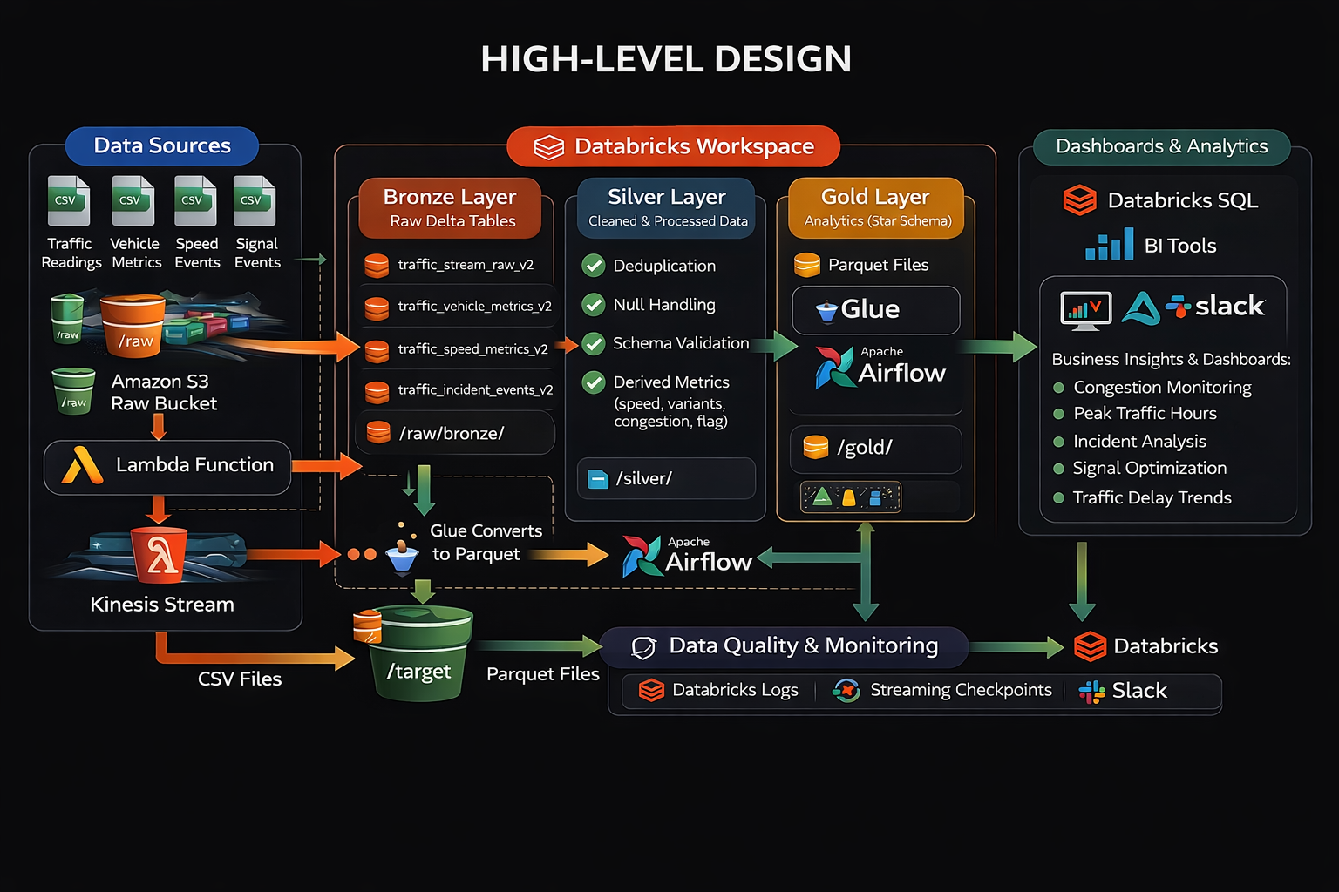
HIGH-LEVEL DESIGH

Slide 6
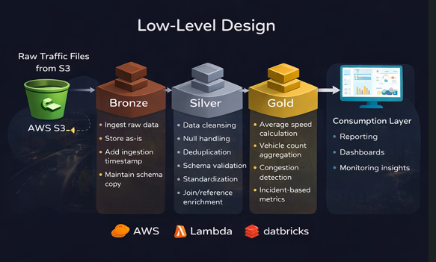

Slide 7
Silver Layer Transformations:
Type Casting
Null Handling
Text Cleaning
Deduplication
Filter Bad Data
Enrichment
Timestamp Split
Outlier Flagging
DQ Score
Partitioned Write

Slide 8
ERROR HANDLING & QUALITY CHECKS
Schema Validation – Enforce predefined schema in the Bronze layer (column names, data types, mandatory fields) to ensure consistency and prevent malformed traffic records.
Deduplication & Integrity Checks – Remove duplicate traffic records and validate unique identifiers (e.g., sensor_id, timestamp) in the Silver layer to maintain data integrity.
Null & Anomaly Handling – Apply rules to handle missing or invalid values (e.g., null speed, unrealistic vehicle count, negative values) to ensure accurate analytics.
Error Logging – Capture invalid or failed traffic records into a separate error table in Databricks with details such as timestamp, error type, and source file for debugging and auditing.
Data Quality Rules – Implement threshold-based checks (e.g., speed limits, congestion thresholds) to ensure only valid and meaningful data is processed for downstream analytics.

Slide 9
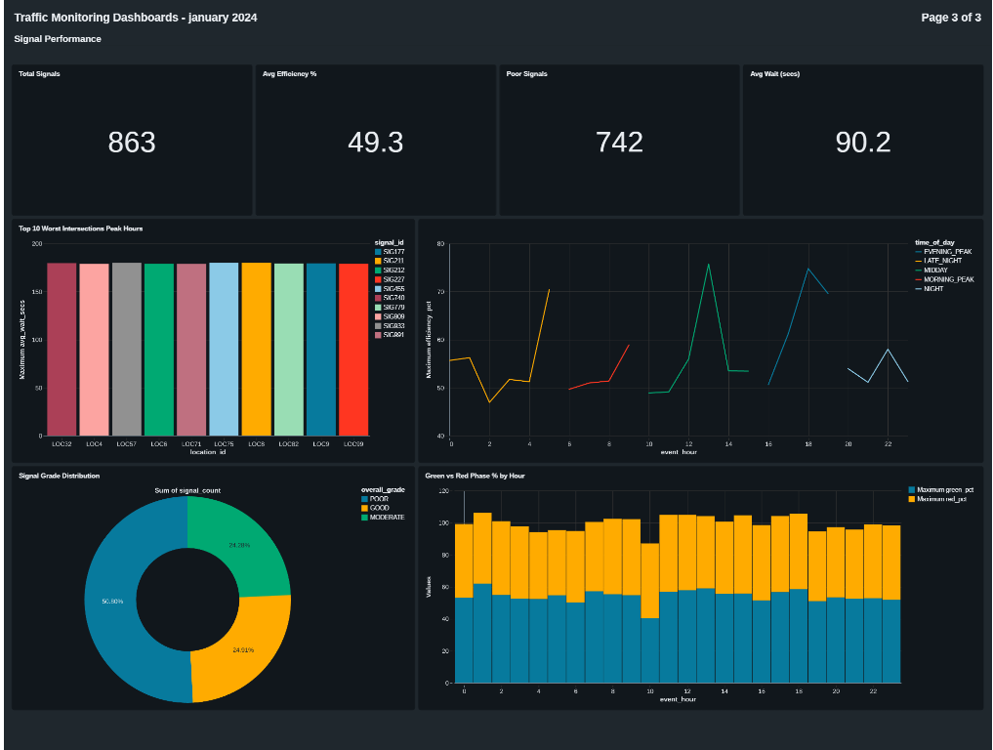
Dashboards

Slide 10
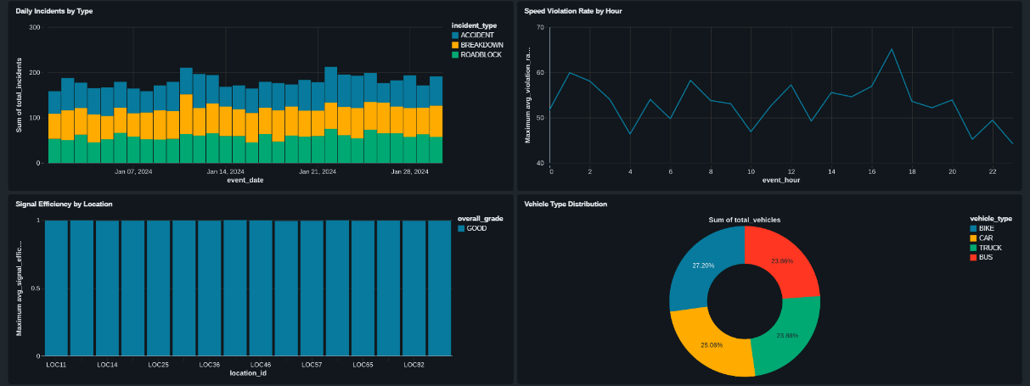

Slide 11
Pipeline Orchestration
Apache Airflow Scheduling – Use Apache Airflow to schedule and manage end-to-end traffic data pipeline workflows at defined intervals (real-time or batch triggers).
DAG-Based Workflow Management – Design Directed Acyclic Graphs (DAGs) to define and control the sequence of tasks such as ingestion, transformation, and loading across Bronze, Silver, and Gold layers.
Automated Job Execution – Enable fully automated execution of Databricks jobs and AWS processes without manual intervention, ensuring continuous data processing.
Dependency Management – Configure task dependencies within DAGs to ensure correct execution order (e.g., Silver layer runs only after Bronze completion).
Failure Handling & Retries – Implement retry mechanisms and failure handling in Airflow to automatically re-run failed tasks and maintain pipeline reliability

Slide 12
Alerts / Monitoring / Logging
Slack Alerts – Send real-time notifications to Slack channels whenever pipeline failures, delays, or anomalies occur to enable quick response from the team.
Databricks Logging – Maintain detailed logs within Databricks jobs to capture execution status, errors, and processing details for debugging and auditing.
Pipeline Health Monitoring – Continuously monitor the overall pipeline status (success, failure, running state) to ensure smooth and reliable data processing.
Processing Time & Error Tracking – Track job execution time, performance metrics, and error rates to identify bottlenecks and improve pipeline efficiency.
AWS CloudWatch Monitoring – Use CloudWatch to monitor AWS resources, track system performance, and detect issues in real time for proactive maintenance

Slide 13
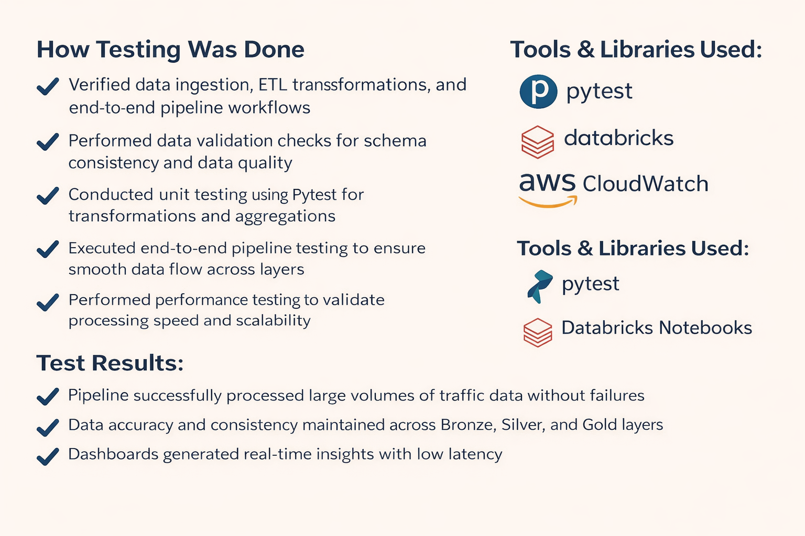
Testing & Validation

Slide 14
BUSINESS IMPACT & OUTCOMES
Improved traffic data quality with accurate, clean, and reliable datasets.
Faster insights and reduced decision latency through real-time data processing.
Enhanced traffic management with analytics-driven congestion detection and monitoring.
Increased efficiency by automating data pipelines and minimizing manual intervention.
Scalable and cost-efficient solution using cloud-based architecture (AWS & Databricks).
Better operational outcomes by enabling real-time monitoring and data-driven decision-making.

Slide 15
Thank You

